Slide 1
Pineapple Resort
Our software allows for prospective guests to search for open rooms via date or type, they can also book their desired room and edit their booking details. A manager is able to handle special cases such as cancellations and changes.
Alex Chamorro, Brian Ciszewski, Garett Flagg, Dylan Ingram, Alan Norman

Slide 2
Video Demonstration
Video Link
https://drive.google.com/file/d/16QNWvTZ2iOgmSccFxaC_YpZheIzOchHI/view?usp=sharing
Backup Link
https://drive.google.com/file/d/1bLtTioZ6C1vByubiGugaqr_R2ElWIWp-/view?usp=sharing

Slide 3
Summary
Technologies Used
H2 Database
Oracle Scene Builder 2.0
IntelliJ Idea
Features
Room booking system
Special manager access
Edit account and booking details
Bugs
None currently (That we know of)

Slide 4
Thank you. Any questions?

Slide 5
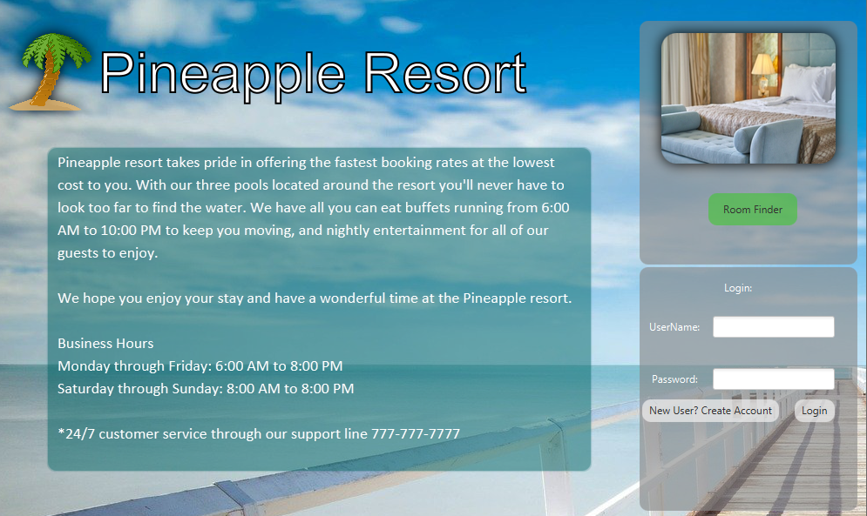

Slide 6
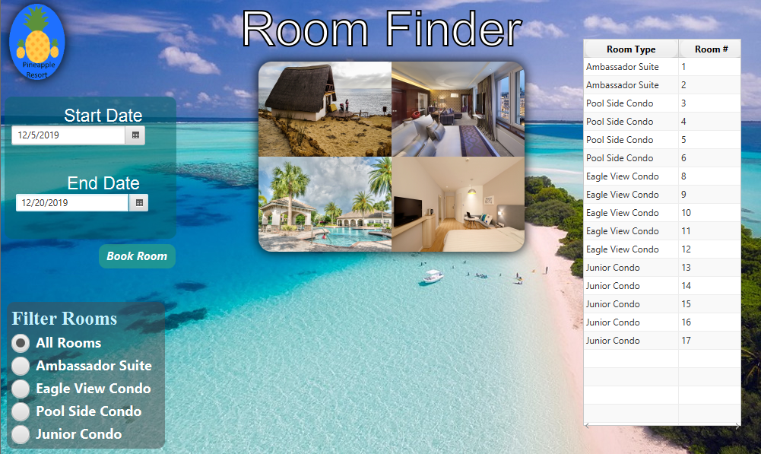

Slide 7
